Slide 1


Job Board Platform
Dinesh Perni
Osama Khan
Umutbek Abdimanan Uulu
Masters of Computer Science (MSCS)
School of Technology & Computing (STC)

Slide 2
Agenda
Problem statement
Introduction
Background
Methodology
Frontend
Backend
Database used
Softwares used
Conclusion
Future Work
Key Reference
Q&A

Slide 3
Problem Statement
The job market is highly competitive, especially for freshly graduated individuals who lack real-time experience but possess enthusiasm and a strong network of connections. To address this challenge and create a platform exclusively tailored to the needs of these young and fresh graduates and professionals, we propose a Job Portal project.

Slide 4
Problem statement…
This project intends to describe the creation of a Full stack Job Portal using the MERN Stack, which will consist of React, MongoDB, Node.js, and Express.js.

Slide 5
Something to relate to…
The group is at a point in their studies where they must start applying for jobs and are looking everywhere to get their hands on an opportunity that could land them a suitable job. Not to go very far in the past but the idea for this project was aroused by taking the most recent circumstances into consideration that a typical fresh graduate would face. All of us at one point in our lives face issues like this and in today’s competitive market standing out from people with years of experience is not possible unless you compete at your own level. There are people switching careers and in doing so they have the managerial experiences of decades, but they present themselves as fresh graduates when they change their field of study which should not be the case, having experienced situations like these the group thought putting the idea into action.

Slide 6
Methodology
We kept it simple
Frontend
Backend

Slide 7
Frontend
Starting off with the basics
Frontend refers to the part of a software application or website that interacts directly with the user.
It is the user interface (UI), consists of everything the user experiences directly: text, images, buttons, layouts, animations, and any interactions.

Slide 8
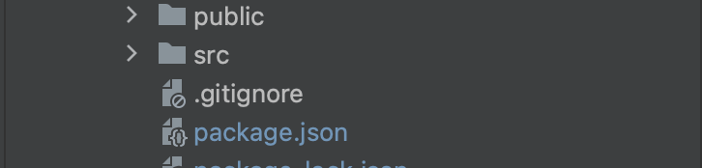
Frontend…
separate the codes into directories.
public - the index.html file and general information about the project.
package.json file contains information about the external libraries included in the project.
src - writes executable code and saves media files

Slide 9
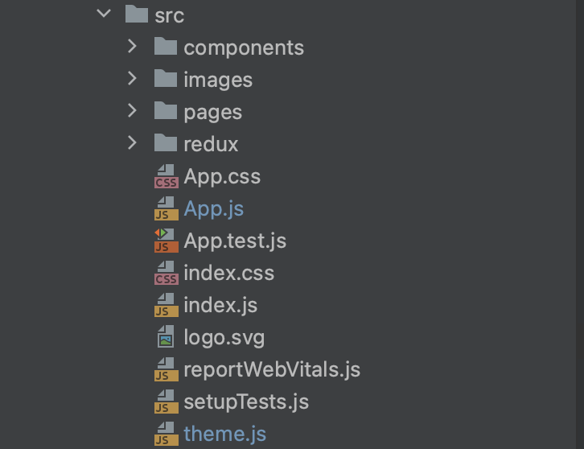
Frontend…
src - writes executable code and saves media files.
components - records components (folders and keys) that have been used more than once.
Images – used images
pages - contains pages. Uses components and containers inside.
redux -Writes the logic for saving, modifying, disabling and accessing a web application.
index.js- file describes the integration of the response and the react library.

Slide 10
Frontend…
Software and tools used :
React.js: Open-source JavaScript library developed by Facebook, primarily used for building user interfaces in single-page applications.
Npm package manager: NPM is a package manager for the JavaScript language.
Redux Framework: Redux is a status management library for JavaScript applications. It helps to write stable applications that run in different environments (client, server) and are easy to test.
Material-UI (MUI): A Comprehensive React Component Library that provides a set of pre-built components following the Material Design guidelines developed by Google.

Slide 11
Backend
In a software design project backend work is to manage and create server-side components, create process to efficiently run them through handling the logic, manage data storage and the interaction with databases. The backend takes in requests from frontend and based on the logics and database connection provides appropriate solution.

Slide 12
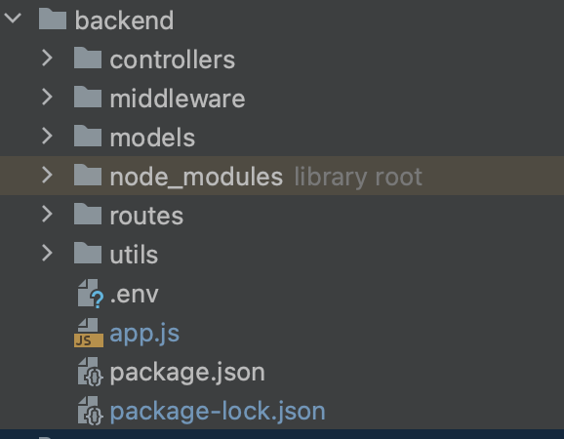
Backend…
The most important thing for Beckend is the creation of the endpoint. Let’s talk about structure of NodeJS backend
Controllers: This directory contains the controller files. Controllers handle the application's logic and interactions between the models and views
Middleware: Middleware functions are functions that can be executed before or after the request reaches the route handler.
Models: This directory contains the model files. Models are used to define the structure and behavior of the data.

Slide 13
Backend…
Utils: The "utils" directory often contains utility files that contain reusable functions or modules that can be used across different parts of your application.
Routes: Routes define the endpoints that your application exposes to handle HTTP requests.
.env: This is a configuration file where you can store environment-specific variables, such as database connection strings, API keys, and other sensitive information.
App.js: This is the entry point of your application. It's where you set up your server, configure middleware, define routes, and start listening for incoming requests.
package.json: This file contains metadata about your application, including its name, version, dependencies, and scripts. It's used by npm (Node Package Manager) to manage your project's packages and scripts.

Slide 14
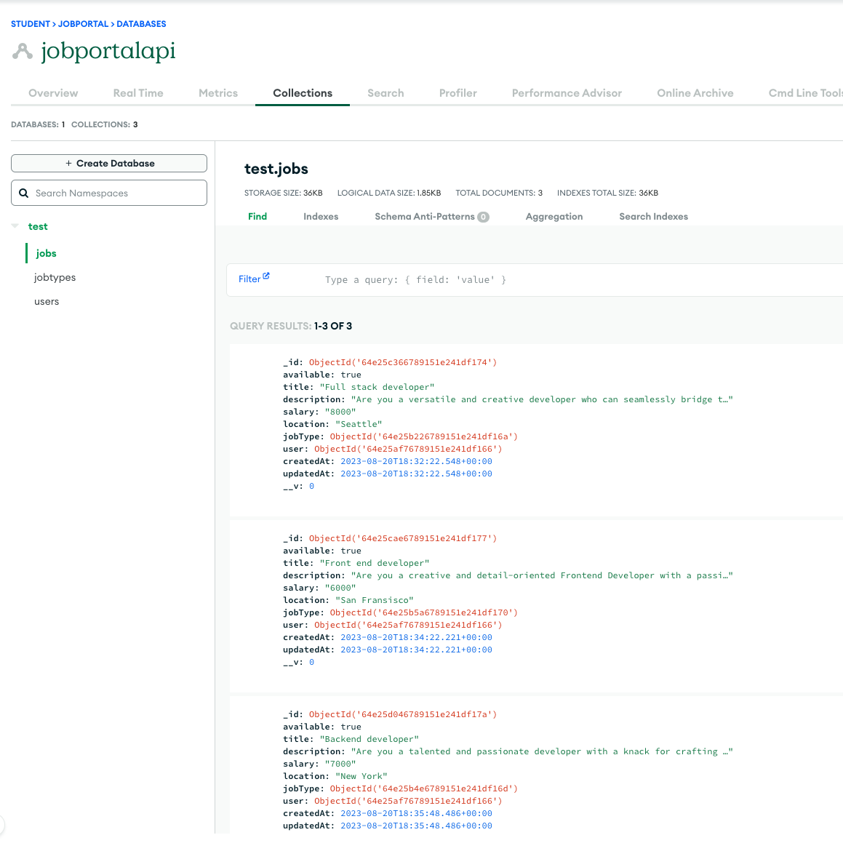
Database - MongoDB
Designed to handle large volumes of unstructured or semi-structured data.
MongoDB's flexibility, scalability, and compatibility with JavaScript align well with the asynchronous, event-driven nature of Node.js. The combination of these technologies can lead to more efficient development, streamlined data management, and the ability to build high-performance real-time applications.

Slide 15
Postman
For API testing.
It is an HTTP client that tests HTTP requests, utilizing a graphical user interface, through which we obtain different types of responses that need to be subsequently validated.
Postman offers many endpoint interaction methods. The following are some of the most used, including their functions:
- GET: Obtain information
- POST: Add information
- PUT: Replace information
- PATCH: Update certain information
- DELETE: Delete information

Slide 16
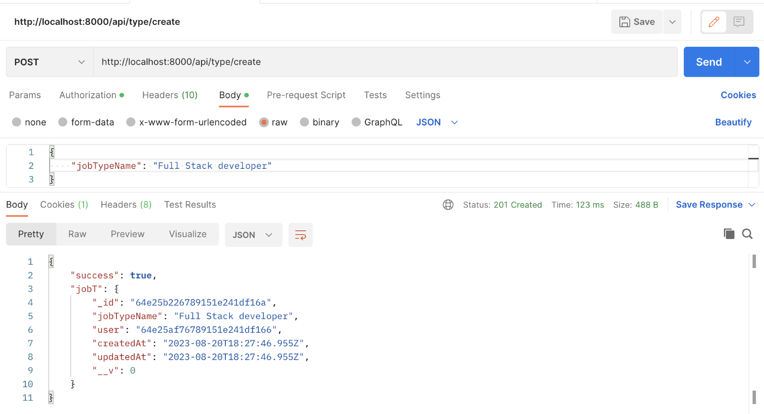
Postman…

Slide 17
GitHub
GitHub has played a pivotal role in driving the growth of open-source software development. It provides a platform for developers to freely share their work, collaborate with others, and contribute to a wide range of projects, ranging from small utilities to large, complex software applications.

Slide 18
Moving on… The Application
Application
The app has two parts:
- User part (freshers)
- Administration part

Slide 19
… The Application
User Part:
Sign Up & Profile Creation: Fresh graduates can sign up.
Job Search & Filtering: Users can search for jobs based on keywords, job category, company name, and location.
Job List: Can see list of Jobs
Application Process: Directly apply for jobs with their profile or upload a specific resume. Users can track the status of their applications (e.g., applied, shortlisted, interviewed, rejected). They can see a list of applied jobs

Slide 20
… The Application
▰Administration Part:
Job Posting: A straightforward interface for recruiters to post job openings, specifying details like job description, qualifications required, salary range, etc.
Specify that the position is for fresh graduates to get relevant applications.
Analytics Dashboard: Track the number of views on a job post, the number of applications received, sources of applications, and more
Create categories: Can create job categories depending on the number and types of jobs available.

Slide 21
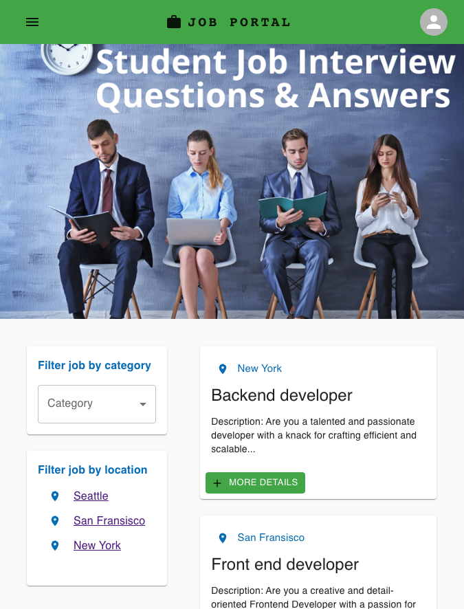
How THE app L oo ks
Main page

Slide 22
The App
Demo

Slide 23
Future Works
▰Adding more options and tools for students and administrators.
▰These will be based on the usage and data collected that would highlight what are the end users requiremnts.

Slide 24


Q&A

